Slide 1
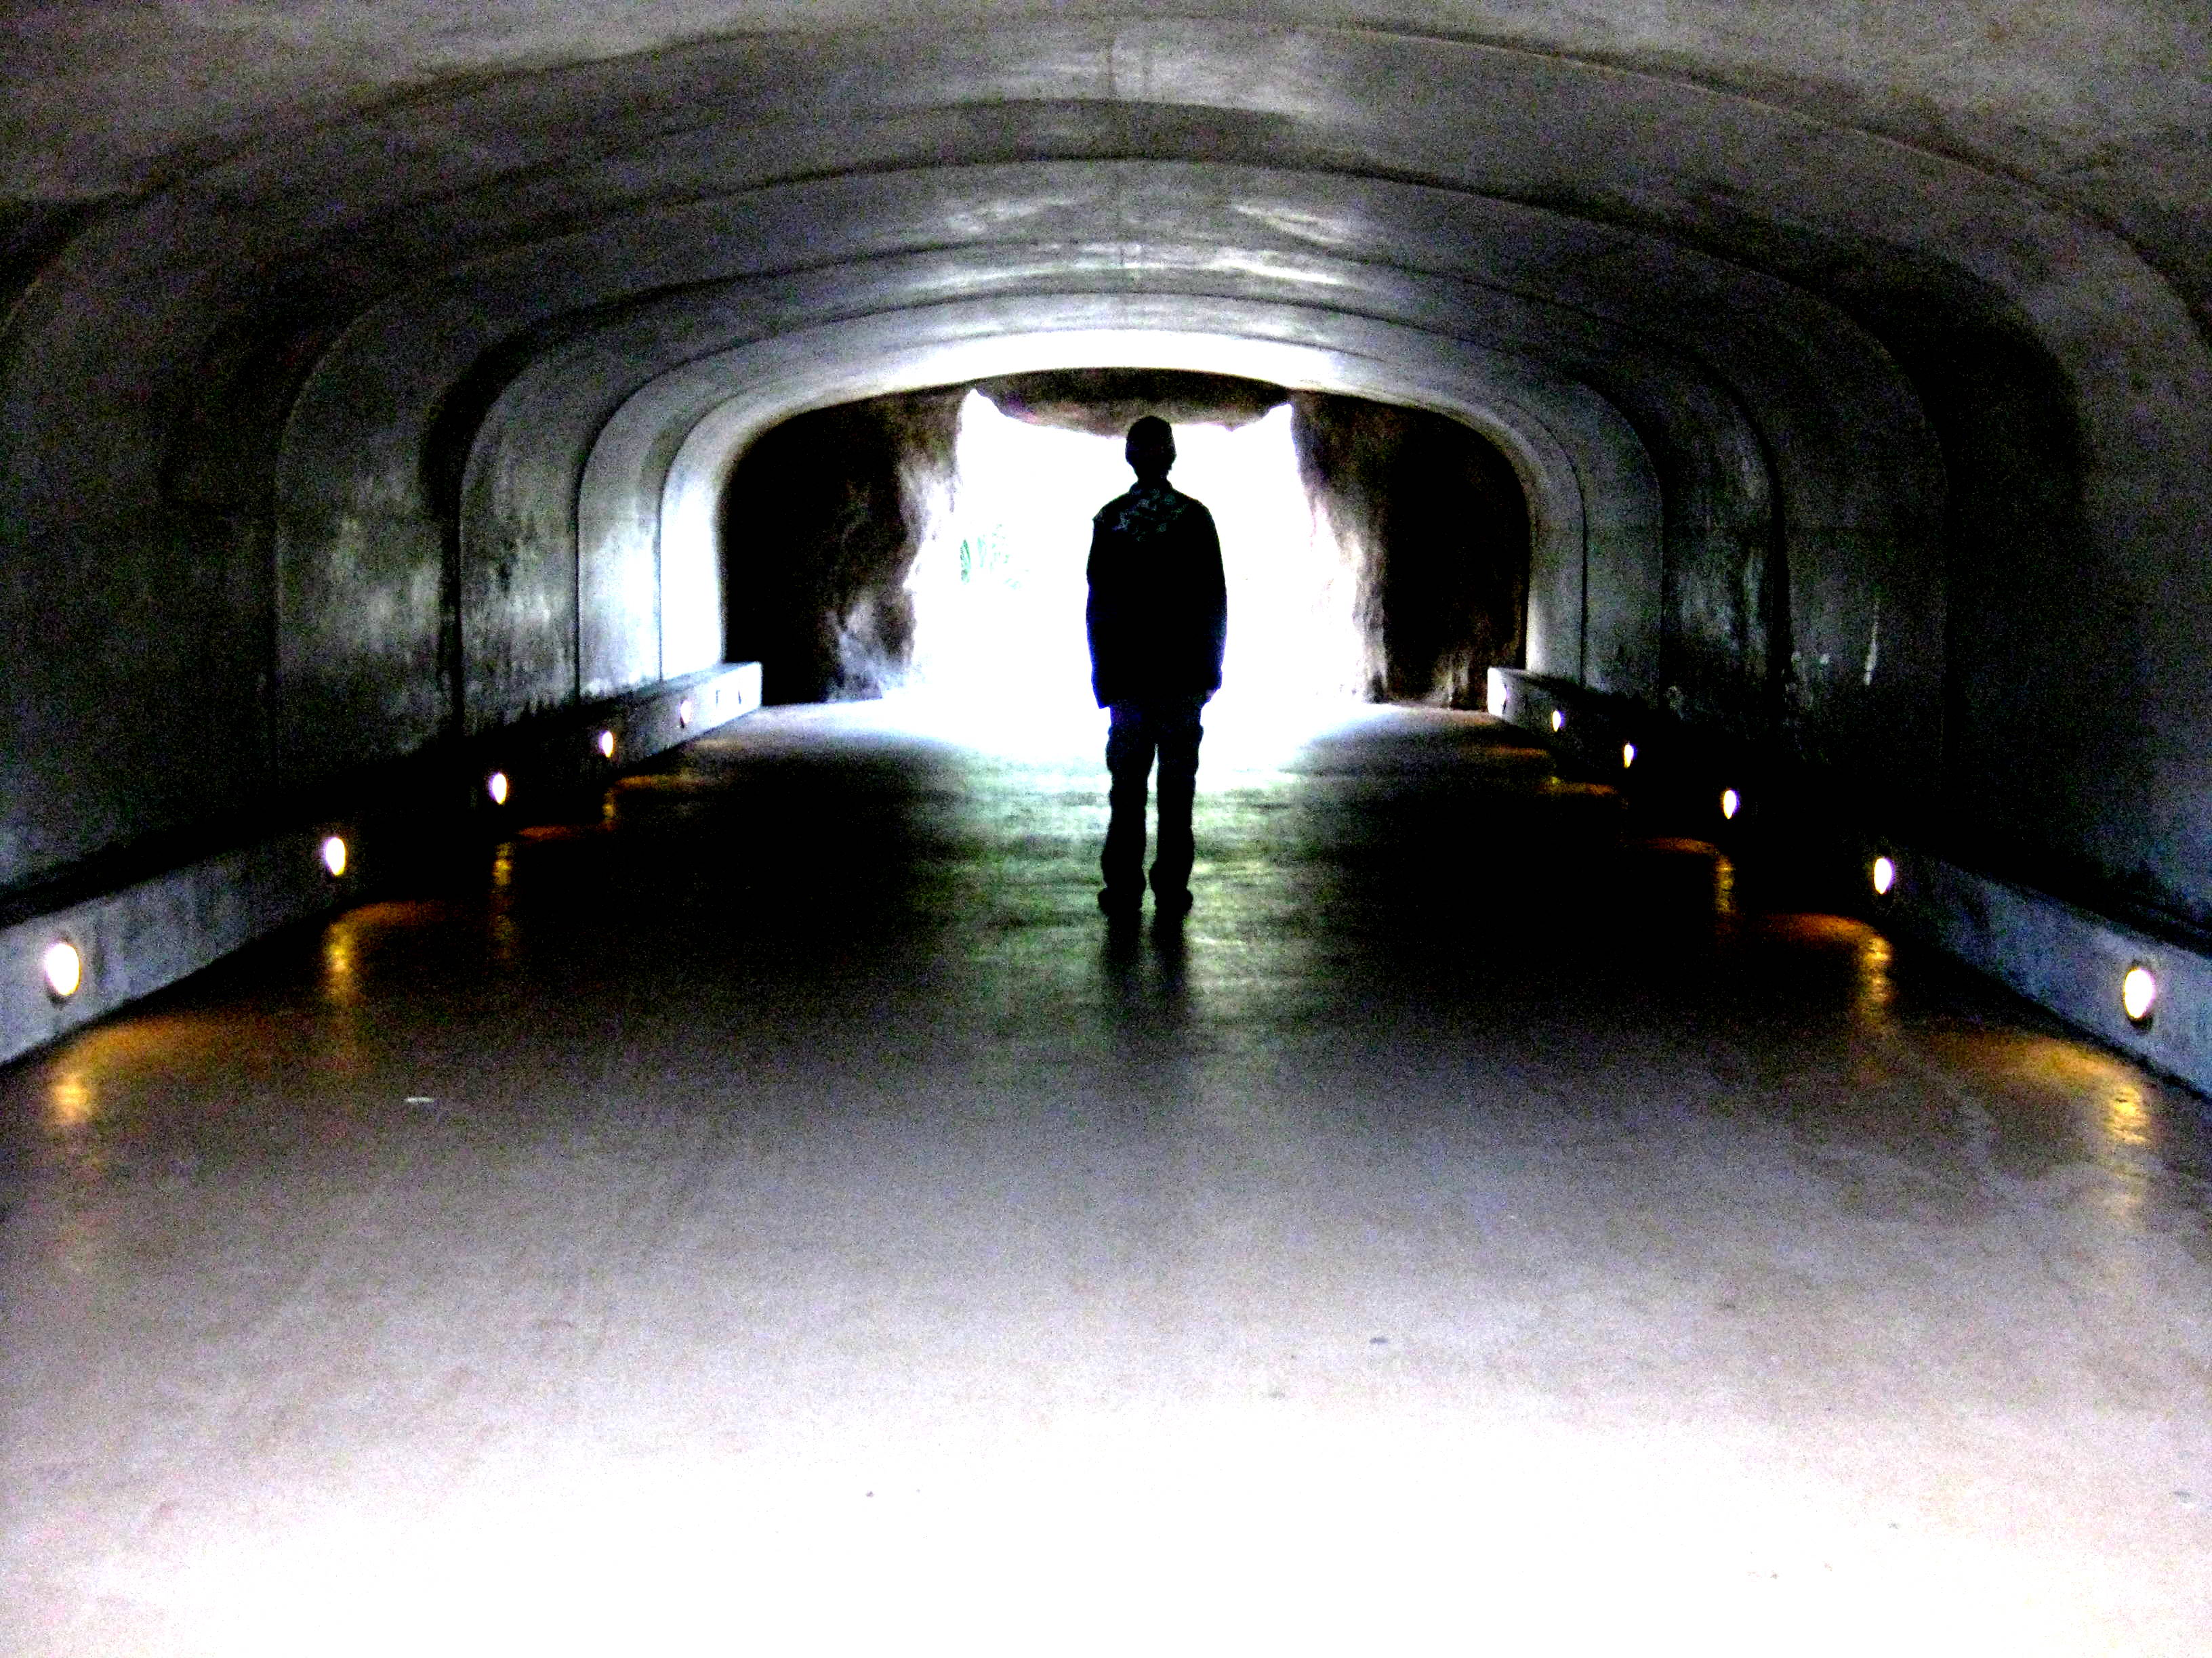
The Hitchhiker
The Hitchhiker
By
Lucille Fletcher
By
Lucille Fletcher

Slide 2
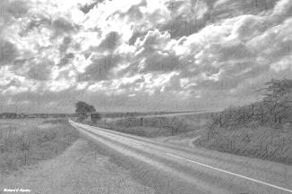
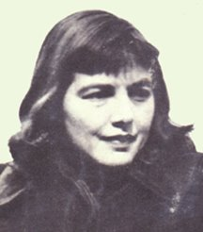
Lucille Fletcher
Violet Lucille Fletcher was born March 28, 1912, in Brooklyn, New York. Her parents were Matthew Emerson Fletcher, a marine draftsman, and the former Violet Anderson, a homemaker.
She graduated from Erasmus Hall High School in 1929 and then went to Vassar College, which was a women's university at that time. She earned a Bachelor of Arts degree in English in 1933, then took a $15 a week job as clerk-typist for CBS radio in New York City.

Slide 3
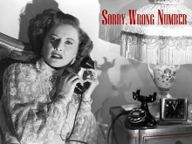
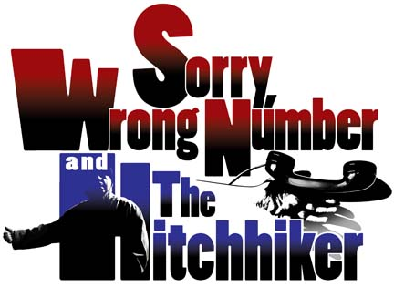
Lucille was a writer at heart. She spent a few days writing a story about a man who drove across the United States and was shadowed by the same hitchhiker everywhere. The story was shown to actor, Orson Welles, who showed it to the production staff for the series Suspense! The episode, "The Hitchhiker", aired on September 2, 1942.
Orson Welles was Ron Adams who drove from Manhattan to Los Angeles on business. It was repeated several times on Suspense! and other series. The story changed her status at CBS from clerk-typist to scriptwriter.
She wrote many other scripts, including another for Suspense!, "Sorry, Wrong Number", which also became a hit motion picture, for which she also wrote the script. "The Hitchhiker" was also revised as an episode of TV's The Twilight Zone, featuring Leonard Strong (1908-80) in the role of the hitchhiker and Inger Stevens (1934-70) in the Orson Welles part as Nan Adams.

Slide 4
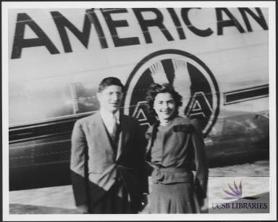
She spent the rest of her life writing nine mystery novels at her homes in suburban Philadelphia.
Lucille died in Langhorne, Pennsylvania, on August 31, 2000, of a stroke at her home. She was 88 years old.

Slide 5
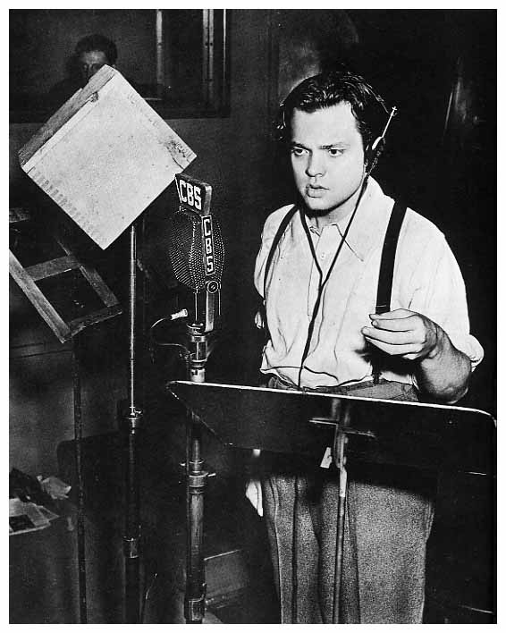
ORSON WELLES
On October 30, 1938, he directed the Mercury Theatre on the Air in a dramatization of “War of the Worlds,” based on the H. G. Wells novel.
Welles set the events in contemporary locations (the landing spot for the Martian invasion, Grover’s Mill, New Jersey, was chosen at random with a New Jersey road map) and dramatized it in the style of a musical program interrupted by news bulletins, complete with eye-witness accounts.

Slide 6
Radio Play adapted from H.G. Wells novel, The War of the Worlds
The Panic
Though the program began with the announcement that it was a story based on a novel and there were several announcements during the program that reiterated that this was just a story, many listeners didn't tune in long enough to hear them.
A lot of the radio listeners had been intently listening to their favorite program the "Chase and Sanborn Hour" and turned the dial, like they did every Sunday, during the musical section of the "Chase and Sanborn Hour" around 8:12. Usually, listeners turned back to the "Chase and Sanborn Hour" when they thought the musical section of the program was over.
However, on this particular evening they were shocked to hear another station carrying news alerts warning of an invasion of Martians attacking Earth. Not hearing the introduction of the play and listening to the authoritative and real sounding commentary and interviews, many believed it to be real.
All across the United States, listeners reacted. Thousands of people called radio stations, police and newspapers. Many in the New England area loaded up their cars and fled their homes. In other areas, people went to churches to pray. People improvised gas masks. Deaths, too, were reported but never confirmed. Many people were hysterical. They thought the end was near.

Slide 7
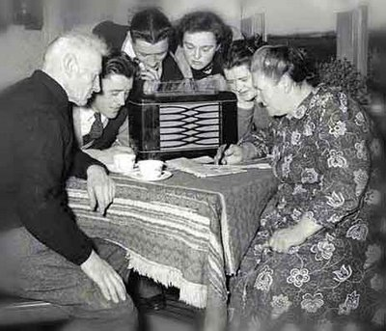
TUNING IN TO A
FAVORITE RADIO
PROGRAM
The Golden Age of Radio (sometimes referred to as old-time radio) refers to a period of radio programming in the United States lasting from the growth of radio broadcasting in the early 1920s until television's replacement of radio as the primary home entertainment medium in the 1950s. During this period, when radio was dominant and filled with a variety of formats and genres, people regularly tuned in to their favorite radio programs. In fact, according to a 1947 survey, 82 out of 100 Americans were found to be radio listeners.

Slide 8
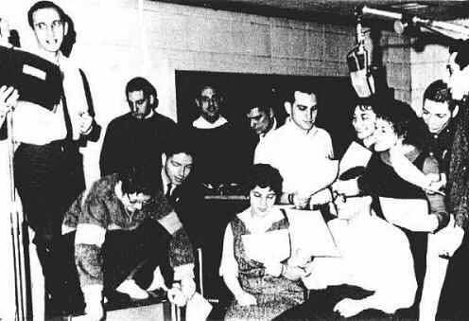
A radio play was written for radio broadcast, which means that it was originally
meant to be heard, not seen.

Slide 9
HOW TO READ A RADIO PLAY
*STAGE DIRECTIONS
These are written instructions that are not read aloud, but are written to help the
actor know how to read his/her lines.
*SOUND EFFECTS
The sound of screeching tires, shattering glass, or other noises help the listener
to “see” what is happening in the play. These sounds suggest the action that is
taking place.

Slide 10
HOW TO READ A RADIO PLAY
*DIALOGUE
These are the words spoken by the actors.
*DIALOGUE AND STAGE DIRECTIONS
Since listeners can’t see the actors, radio playwrights, (the person who writes the drama), give information about the characters through the dialogue and stage directions.

Slide 11
WHAT MAKES A SUSPENSE STORY ?
Thriller is a broad genre of literature, film, and television programming that uses suspense, tension and excitement as the main elements. Thrillers heavily stimulate the viewer's moods giving them a high level of anticipation, ultra-heightened expectation, uncertainty, surprise, anxiety and/or terror. Thrillers and suspense novels tend to be adrenaline-rushing and fast-paced.

Slide 12
WHAT MAKES A
SUSPENSE STORY?
Literary devices such as foreshadowing, red herrings, plot twists and cliffhangers are used extensively.
A thriller is a villain-driven plot, whereby he or she presents obstacles that the protagonist must overcome.

Slide 13
WHAT MAKES A SUSPENSE STORY?
*The protagonist(s) faces death, either their own or somebody else's.
*The force(s) of antagonism must initially be cleverer and/or stronger than the protagonist's.
*The main storyline for the protagonist is either a quest or a character who cannot be put down.
*The main plotline focuses on a mystery that must be solved.
*The film's narrative construction is dominated by the protagonist's point of view.
*All action and characters must be credibly realistic/natural in their representation on screen.
*The two major themes that underpin the thriller genre are the desire for justice and the morality of individuals.
*One small, but significant, aspect of a thriller is the presence of innocence in what is seen as an essentially corrupt world.
*The protagonist(s) and antagonist(s) may battle, themselves and each other, not just on a physical level, but on a mental one as well.
*Either by accident or their own curiousness, characters are dragged into a dangerous conflict or situation that they are not prepared to resolve.

Slide 14
LITERARY TERM TO NOTE
FORESHADOWING
The writer provides HINTS that suggest future events in a story.
A great suspense story will use the literary technique of foreshadowing to build suspense
for the reader.

Slide 15
LITERARY TERM TO NOTE
FORESHADOWING
Foreshadow events in a suspense story or novel. This is arguably the most important technique used in writing any kind of suspense story. Foreshadow events by alluding to them in bits of dialogue. This gives readers
more to anticipate.

Slide 16
LITERARY TERM TO REMEMBER
CONFLICT
The struggle in a story between
opposing forces.
The main character, Ronald Adams, experiences both internal conflict of Man VS Self.
Ronald Adams also experiences external conflict of Man VS Man.

Slide 17
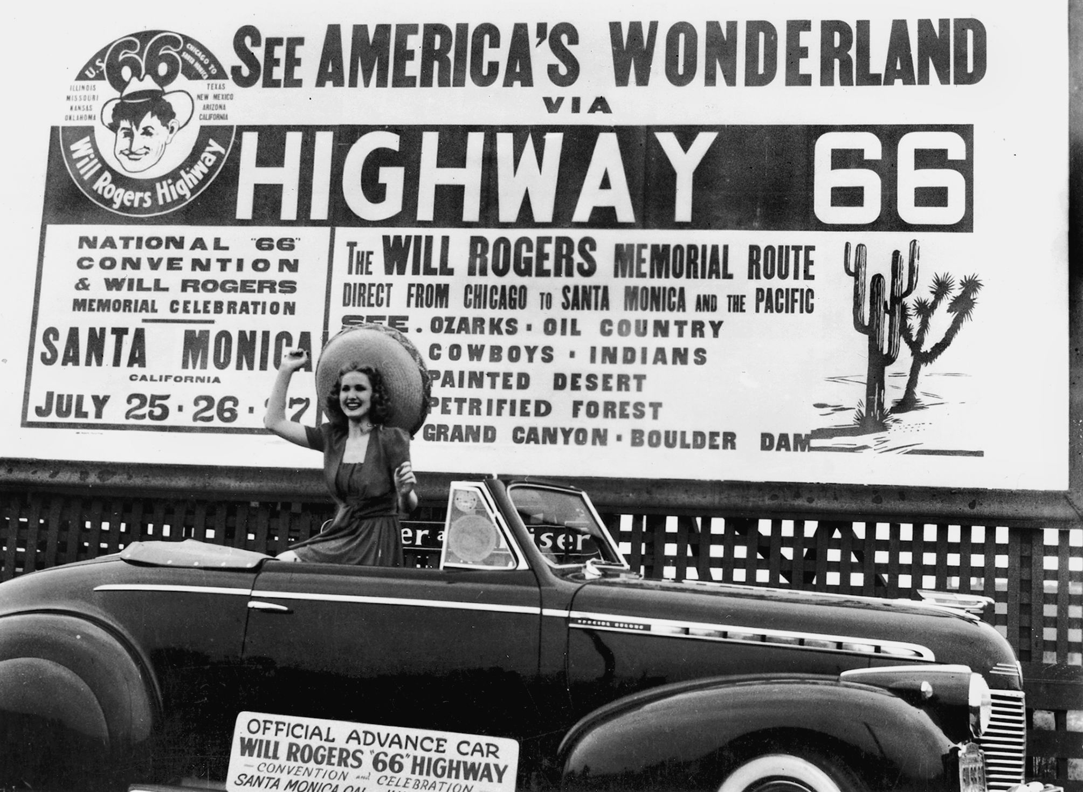
ROUTE 66

Slide 18
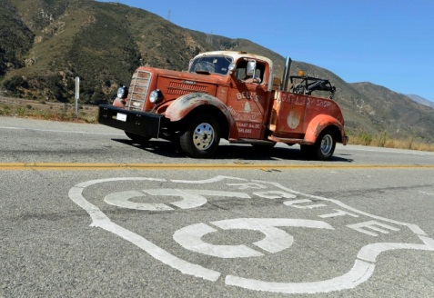
Route 66 was commissioned in 1926.
It was fully paved by the late 1930s.
It ran from Chicago to Los Angeles, creating connections between hundreds of small towns and providing a trucking route through the Southwest.
While not the first long-distance highway, or the most traveled, Route 66 gained fame beyond almost any other road.
The highway, which became one of the most famous roads ran through Missouri, Kansas, Oklahoma, Texas, New Mexico, and Arizona before ending at
Los Angeles, California, covering a total of
2,448 miles.

Slide 19
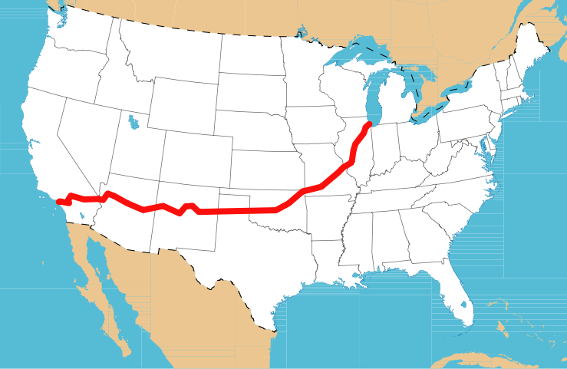
“I was in the heart of the great Texas prairies. There wasn’t a car on the road after the truck went by. I tried to figure out what to do, how to get ahold of myself. If I could find a place to rest.”

Slide 20
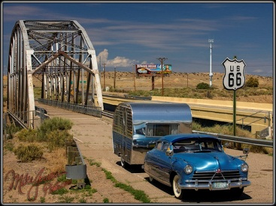
Route 66 was used by many during the Depression of the 1930s as people sought their brighter future by heading to California.

Slide 21
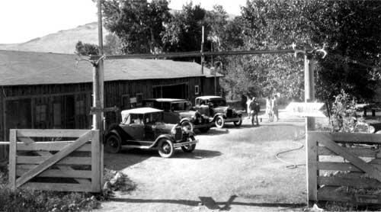
Auto Camp of the 1940s
Auto camps were set up along Route 66 for weary travelers to take a break from the long-distance driving.
Many people merely slept in their cars. Others pulled campers behind the cars or carried tents in the trunks
of their cars.

Slide 22
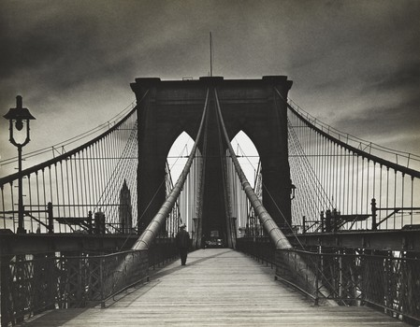
“Crossing the Brooklyn Bridge that morning in the rain, I saw a man leaning against the cables.”
THE BROOKLYN BRIDGE

Slide 23
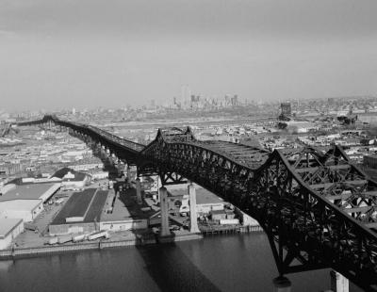
Each day, over 100,000 cars cross the Pulaski Skyway, a span of bridges that feed in and out of the Holland Tunnel connecting Manhattan and New Jersey. Traffic-choked, with hair-raising curves, slopes and exits, the Skyway is loved by few, but needed by many.

Slide 24
CHARACTERS
Protagonist
Ronald Adams
Antagonist
Phantom Hitchhiker (Voice)
Minor Characters
Adams’s Mother
Orson Welles
Mechanic
Henry, a sleepy man
Woman’s Voice (Henry’s wife)
Mrs. Whitney
Hitchhiker Girl
Operator
Long-distance Operator
Albuquerque Operator
New York Operator

Slide 25
GET READY TO READ
IS SEEING BELIEVING?
HAVE YOU EVER SEEN SOMETHING YOU COULDN’T EXPLAIN?
Was that a man in the alley or was that only a shadow? What was that bright shape that streaked across the sky?
Ronald Adams is driving across the country on Route 66.
He is desperate to prove that what he is seeing can be explained!
Get ready to read the suspense drama. The Hitchhiker!

