Slide 1
Literary Genres

Slide 2

What is a Literary Genre?
A “genre” is a particular style or type of writing.

Slide 3
Most Common Genres:
Fiction | Nonfiction
Fables, Folktales, Fairytales | Biography
Fantasy, Mystery | Autobiography
Myth, Legend | Reference
Historical Fiction | Essay, Newspaper Article
Realistic Fiction | Speeches, Diaries, Letters
Science Fiction | Informational
Other Types of Writing: Drama, Poetry

Slide 4
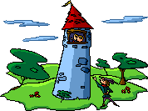
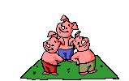
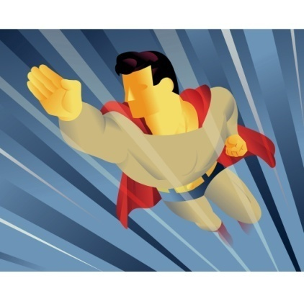

Fiction
Writing that tells about imaginary people and events
Stories that are “made up”

Slide 5
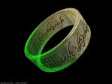
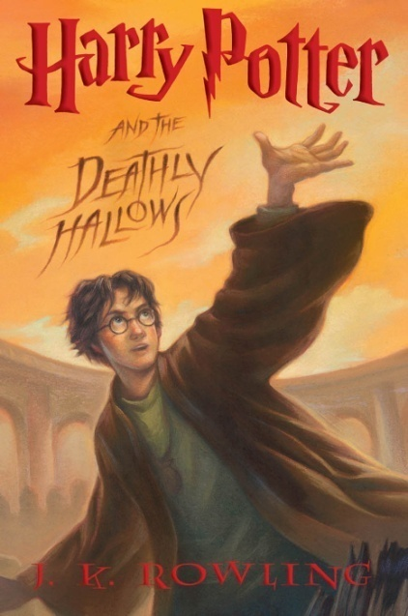
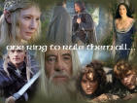

Fantasy
In this type of story, the author has created a magical world where anything is possible.
Fantasy may include magical beings, talking animals or other impossibilities

Slide 6
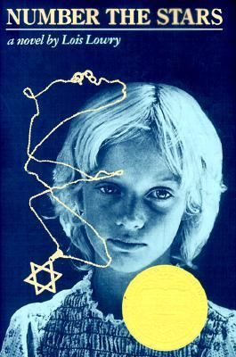
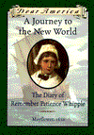

Historical Fiction
Stories with fictional characters and events in a historical setting.
The story takes the reader back to a particular time period where they learn about the everyday life of a person. The character may interact with actual historical characters, but usually, the main character is not based on a real person.

Slide 7

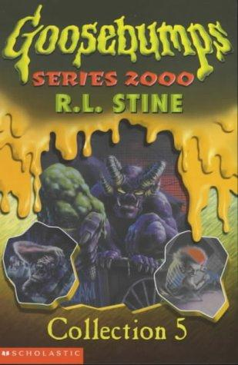
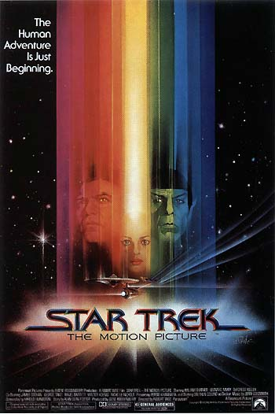

Science Fiction
Stories based on real or imagined inventions, space travel or life in other worlds, usually set in the future. It often explores the unknown.

Slide 8
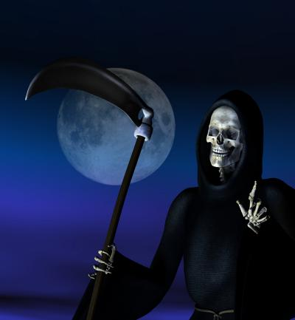
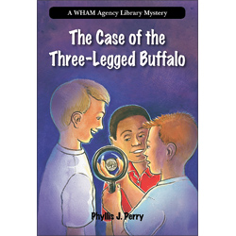
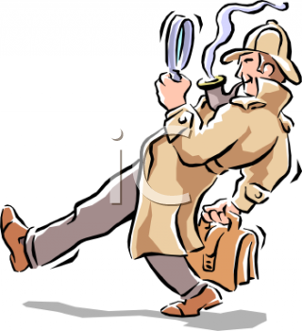
Horror & Mystery
Horror is fiction in which events evoke a feeling of fright in both the characters and the reader.
Mystery is fiction dealing with the solution of a crime or the unraveling of secrets.

Slide 9
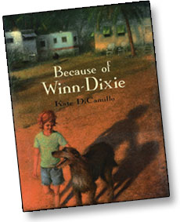
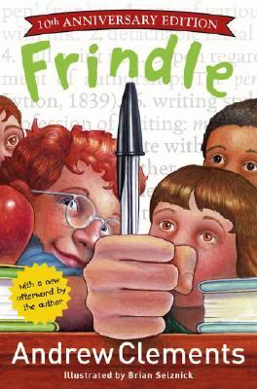
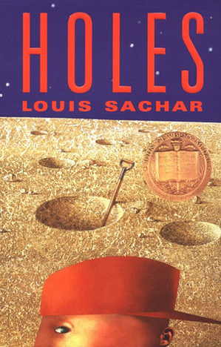
Realistic Fiction
Stories that could actually “happen” in real life.
The setting is realistic
The characters speak and act like real people
The story describes real-life problems and events

Slide 10
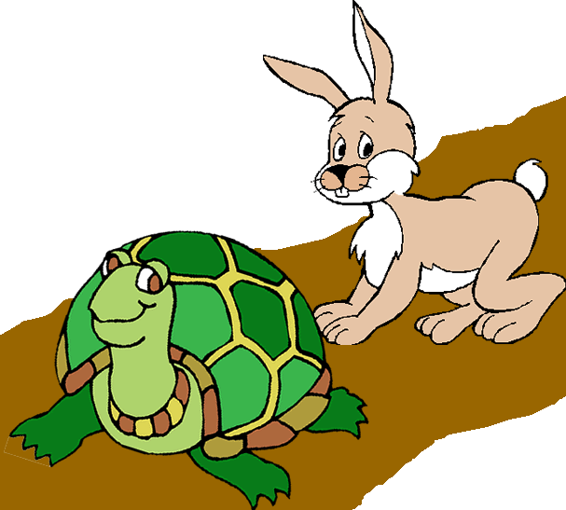
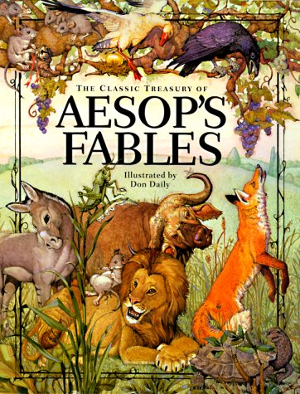
Fable
A short story, usually with animal characters, that teaches a lesson about what is important in life.

Slide 11
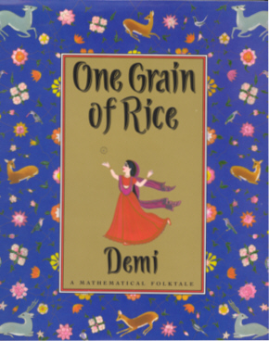
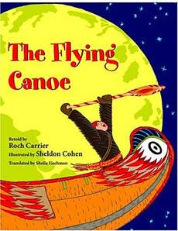
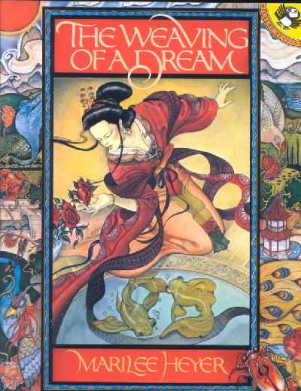
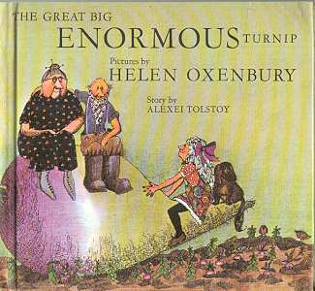
Folk Tale
Story told generation to generation, usually by word of mouth.
Sometimes different versions in different cultures
Original storyteller is unknown
Can involve animals, wishes, magic, trickery and often the number 3

Slide 12
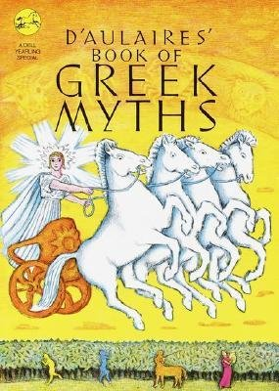
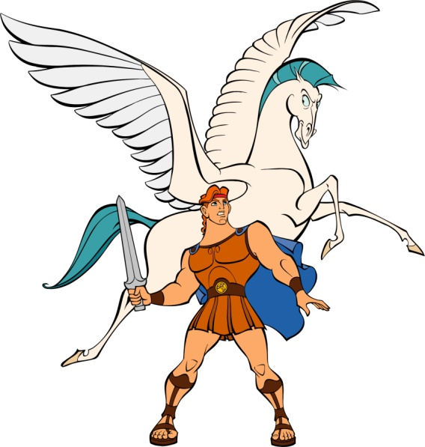
Myths
Myths are early people’s way to explain the universe.
Many gods and goddesses are present in myths
The gods, goddesses, and heroes are super human in nature.
Human emotions are experienced by the gods.
Magic is often present in myths.
Gods sometimes appear in disguised form

Slide 13
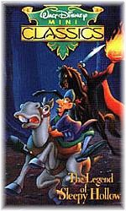
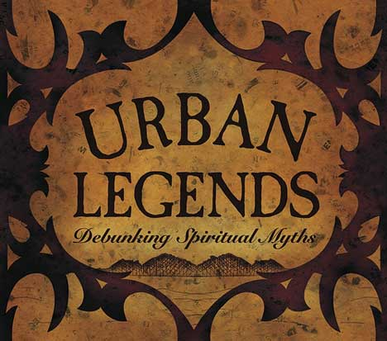
Legend
A story, handed down from the past that people tell as a “true story” but sometimes the details are difficult to confirm.
The person telling the story usually does not claim to be an eyewitness to the events, but “heard” it from someone who knows someone who heard it from someone who was “really” there...
Legends often contain a moral or a lesson and are told to uphold the values of the community.
They often involve supernatural or religious elements

Slide 14
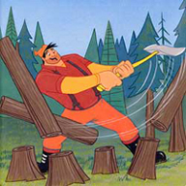
Tall Tale
Extraordinary person - the main character is better at things than an ordinary person
Exaggeration – makes something greater or bigger than it really could be
Explanation – explains how something came to be

Slide 15
Fairy Tales
Often begins with “Once upon a time” or “Long, long ago…”
Includes a good character and a bad (evil) character
Includes magic or something enchanted
Involves a problem that is solved and the good people live happily ever after
Setting is often a forest or a castle

Slide 16
Non-Fiction
~ Accounts of real people, places and events
~ Fact, NOT fiction…
(that’s why it’s called NON-Fiction.
Biography autobiography informational
Textbook instructional reference books

Slide 17
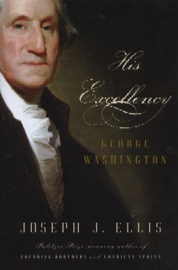
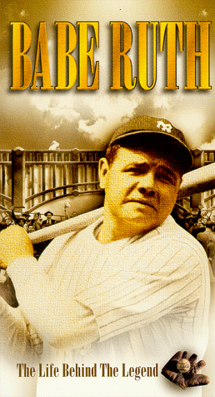
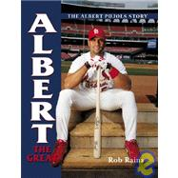
Biographies
A biography is a true story about a person’s life or parts of his/her life
Written in 3rd person point of view (he or she)

Slide 18
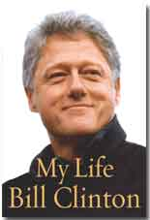
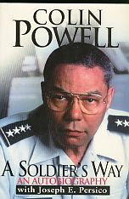


Autobiographies
Autobiographies are books that people write about their own life.
Written in 1st person point of view (I, me, my)

Slide 19
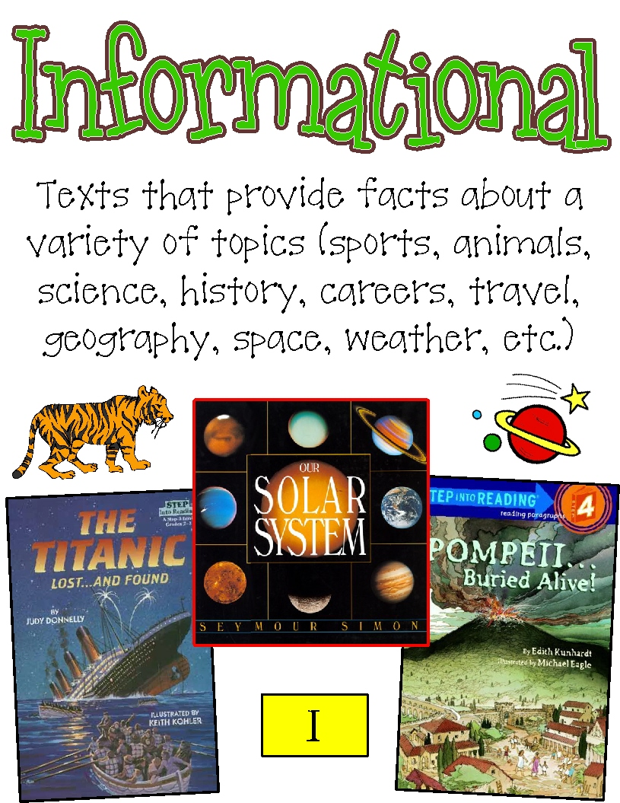
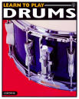
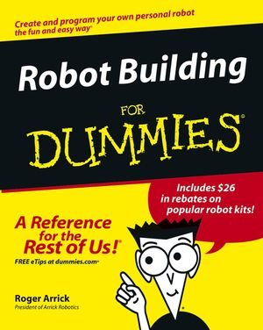
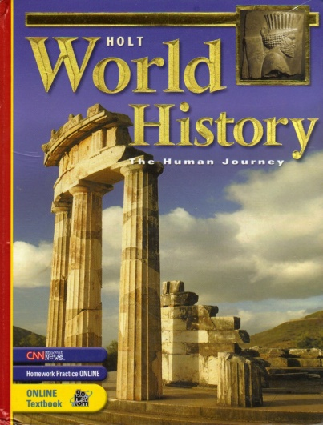
Informational Writing

Slide 20
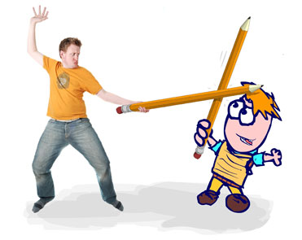
Other Types of Writing….

Slide 21
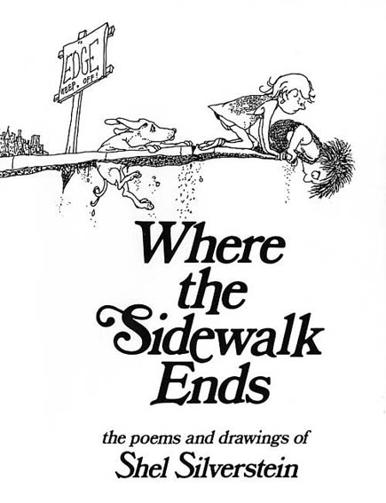
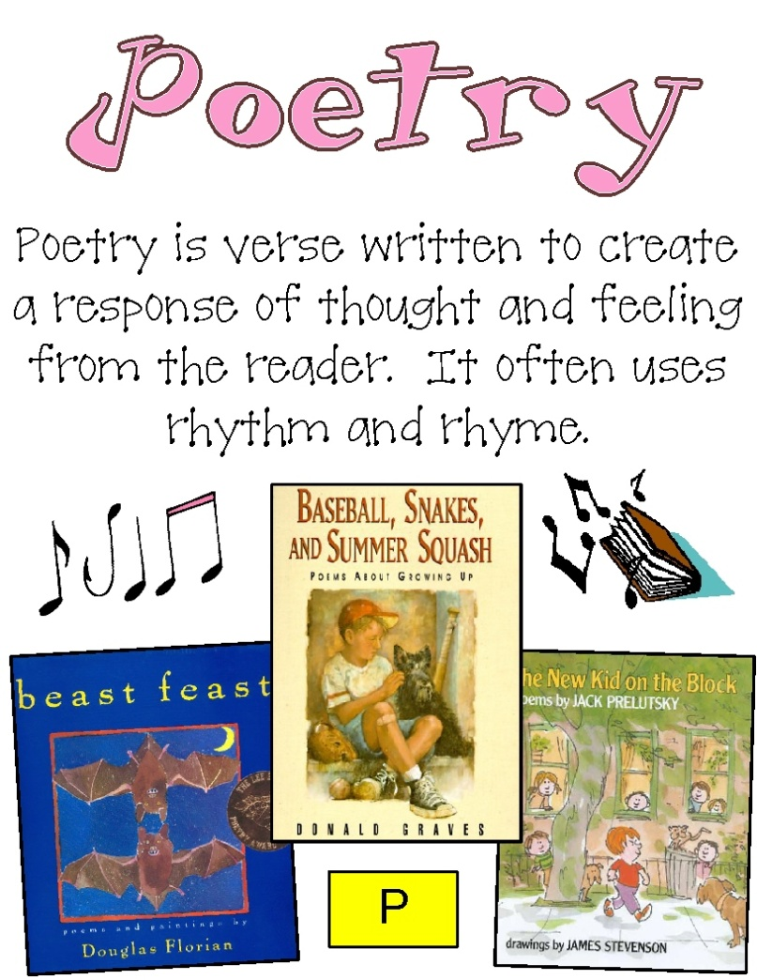
Poetry
lines of poetry (verses) are written in stanzas
may include patterns of rhyme to capture the reader’s interest
uses carefully selected words and phrases to create vivid pictures in the reader’s mind

Slide 22

Drama/Plays
  Presented to an audience
  Has a cast of characters
  May have a narrator who gives important information
  Parts called acts or scenes
  Has props to help support action
  Dialogue that tells what the actors say
  Stage directions in italics

Slide 23
Your Turn…
Name the “genre” of literature for each selection….
1. A book titled “How to be the Best Gardener”
2. A novel about a boy who grows up in the city and learns about life the hard way.
3. A book titled “All About My Life”
A story about two robots who find a ray gun and take over the planet
“George Washington, the President” by Adam Wessel
Shaden dropped the magic ring to the ground and said “Be gone dragons!”
Andy and Madeline solved the mystery….it was Old Man Winters all along!
The moral of the story, The Ant and the Grasshopper is “Plan Ahead!”
Autobiography Non-Fiction Realistic Fiction Fable Science Fiction Mystery Fantasy Biography

